Slide 1

CJIS-Central Repository
Terry Gilmore, Manager
CJIS-CR
Customer Response Services Unit

Slide 2
Agenda
Our Responsibility As An Agency
How To Acquire An Authorization Number
How To Use the Authorization Number
How To Receive CHRI
Maintenance
Rap Back Program Overview

Slide 3
Our Responsibility As An Agency
Solely Responsible for:
  Collect, Store and Manage CHRI
  Disseminate CHRI to Authorized Agencies
  Submit CHRI to FBI CJIS Division
  Expunge CHRI

Slide 4
How to Acquire An Authorization Number
The authorization number allows an agency to receive criminal history record information on their potential employees for employment within their organization
Legal Management Team will send out the User Agreement via email & the agency will review documents
Once legal receives documents, only then will the authorization number be initiated for the requesting agency
Short Bio,
IRS Tax ID/ EIN#
Business License
General Registration Form www.dpscs@maryland.gov
All Paperwork receive from agency will be reviewed by CJIS
The User Agreement must be signed and mail back to the Legal Management Team
The following document will be sent via email to the agency
Approval Letter 365 days request form Pre-Live Scan Registration Form Instructions for Certified Mail

Slide 5
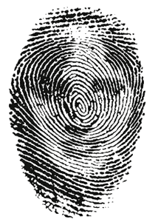
How to Use the Authorization Number
Fingerprint Sites
Pre-Live Scan Registration Form
Fingerprint Rejections

Slide 6
Fingerprint Rejections
There must be a minimum of two fingerprint rejections before a name and date of birth can be requested by the agency.
The rejection letter must be presented when getting reprinted; also you have 60 days from the time of the first rejection to get reprinted before associated fees are required.
*(Remember the reprint must be under the orginal tracking/reference number when the request is made)

Slide 7

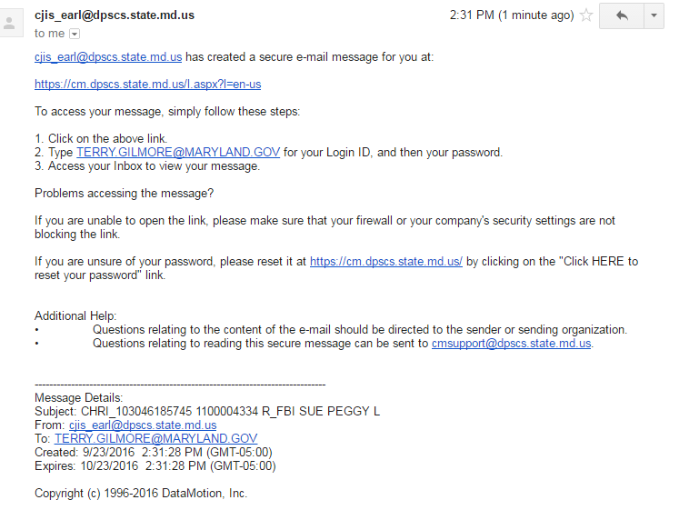
How To Receive CHRI

Slide 8

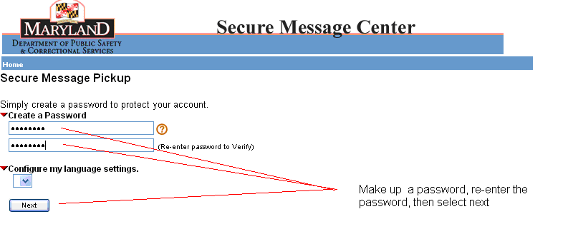
Create Password

Slide 9
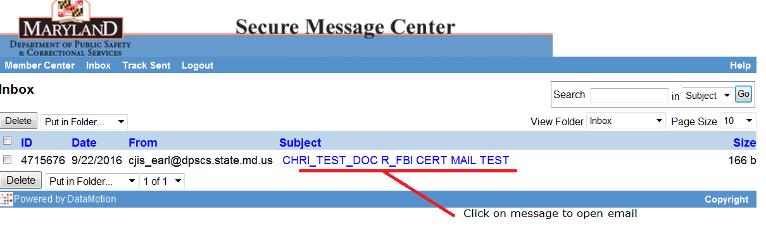
Certified Mail Attachment

Slide 10

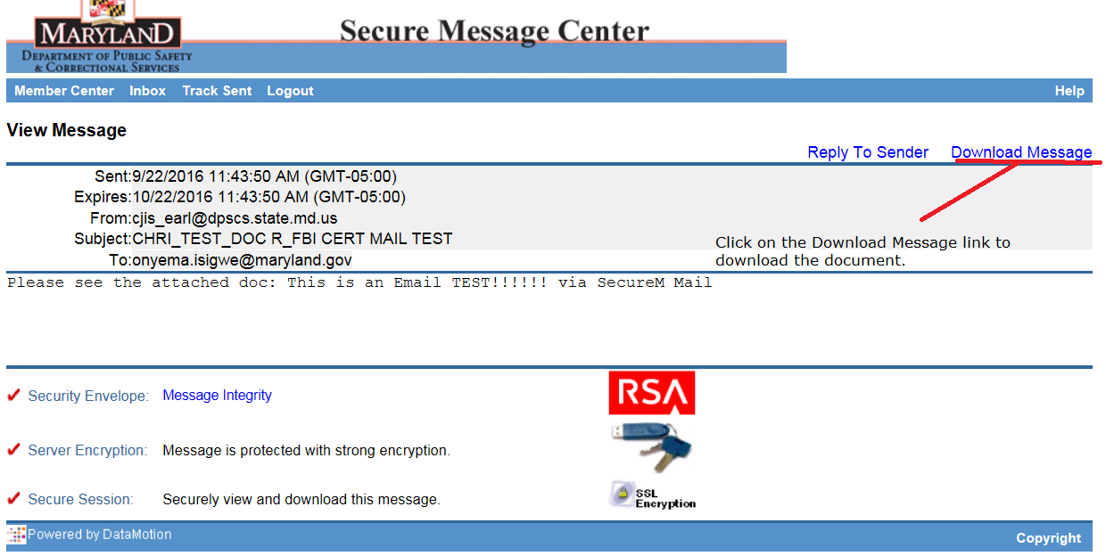
Certified Mail

Slide 11
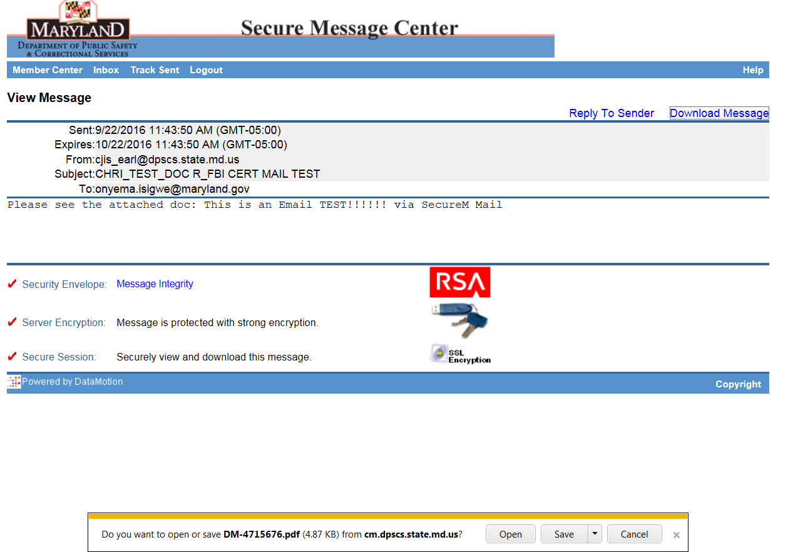
Open Document

Slide 12
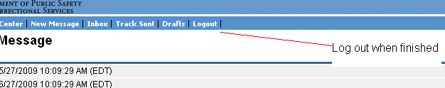
Log Out

Slide 13
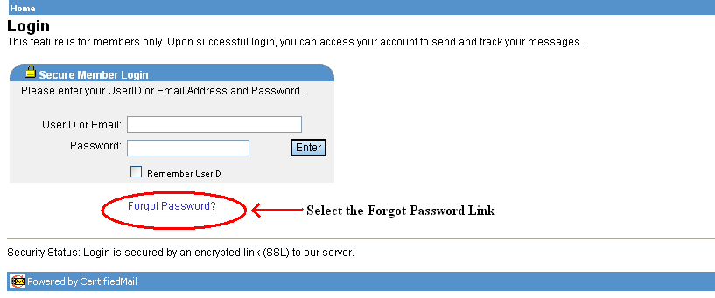
Lost or Forgotten Password
Instructions for lost or forgotten password
Open Email message, see image below, then

Slide 14
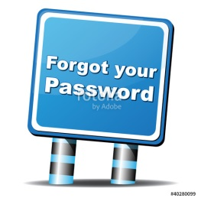
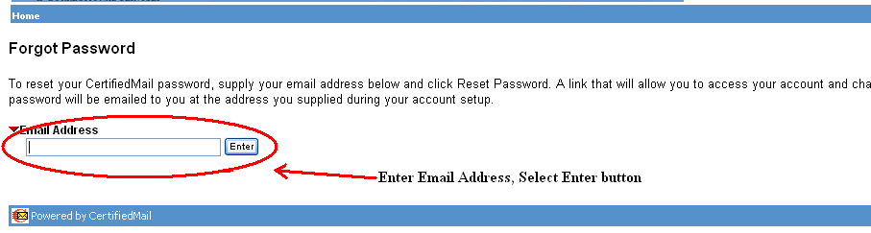
Forgot Password

Slide 15

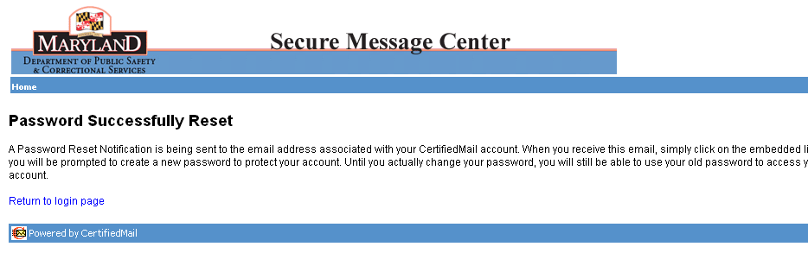
Password Successfully Reset
A Password Notification Message will be sent to your Email address

Slide 16
Maintenance
Authorization Update Form
365 Day Request Form

Slide 17
Reasons for Rejection
365 Day Request Form
Invalid reference number
Invalid authorization number
Authorization number is not approved for request type
The application associated with this reference number was received more than 365 days before receipt of this request
Authorized Signature is missing
Application is incomplete

Slide 18


Rap Back Program Overview
The Program Scope
  FBI NEXT GENERATION IDENTIFICATION (NGI) RAP BACK IS A PROGRAM THAT EXTENDS NATIONAL RAP BACK SERVICES TO NON-CRIMINAL JUSTICE LICENSING, CHILDCARE AND GOVERNMENTAL AGENCIES.
  RAP BACK SERVICES PROVIDES NON-CRIMINAL JUSTICE AGENCIES A MEANS TO RECEIVE NATIONWIDE CRIMINAL HISTORY RECORD INFORMATION (CHRI) RELATED TO APPLICANTS AND EMPLOYEES AFTER THE INITIAL FINGERPRINT SEARCH, THAT IS DURING THE TIME THOSE PERSONS ARE SERVING IN POSITIONS OF TRUST.
  ANY NON-CRIMINAL JUSTICE AGENCY THAT WISHES TO RECEIVE NATIONWIDE CRIMINAL HISTORY RECORD INFORMATION (CHRI) MUST SUBSCRIBE TO THE RAP BACK SERVICES PROGRAM THROUGH MD-CJIS.

Slide 19

Non-Criminal Justice Rap Back
3 Main Functions
Non-Criminal Justice Rap Back refers to the following functions:
  Search: Submission of fingerprints for civil applicants, volunteers, licensees to a repository such as CJIS-Central Repository or the FBI NGI system.
  Retain: As new identities are matched to existing identities the fingerprints will be retained in the FBI NGI System for retention.
  Notify: Notification of any future reported events selected as Rap Back Triggering Events, for which the Subscriber is authorized to receive.

Slide 20
Non-Criminal Justice Rap Back Workflow
  Whenever a subscribed applicant has a future “triggering event” anywhere in the United States, the FBI will send a notification to Maryland’s State Rap Back System to the authorized agencies that have has an active subscriptions on these individuals.
  Triggering events are :
  Arrest
  Dispositions
  Warrant entry with FBI/UCN included
  Warrant Deletion
  Warrant Modification
  Sex Offender Registry entry with FBI/UCN included
  Sex Offender Registry Deletion
  Sex Offender Registry Modification
  The end result is that subscribed agencies will now receive FBI NGI Rap Back Activity Notifications for all out-of-state events, which were previously unavailable.

Slide 21

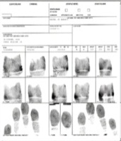
Civil Applicant is Printed for Child Care
Rap Back System
State Identification Bureau
UCN
G145789PX
FBI NGI
Civil
Civil
Prints will be retained
Added to FBI NGI Rap Back System
At anytime the subscription can be added

Slide 22
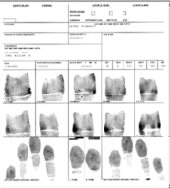
Individual Is Arrested Out of State
Out of State Law Enforcement
Out of State
State Identification Bureau
Criminal
FBI NGI
Criminal
Criminal
Civil
Positive ID Response/ Biographic Info Only
State Identification Bureau
Notification to
Child Care Agency
FBI NGI System will send a notification to the State Identification Bureau

Slide 23
Non-Criminal Justice Rap Back Quick Facts
  There is no fee for the Rap Back subscription
  The agencies will set the subscription in a web base portal application called S.A.M.
  The subscription must be validated every year as long as the employee remains employed there.
  If there is no activity after 3 years, the subscription will automatically be deactivated.
  When the employee resigns or is terminated, it is the agencies responsible to deactivate that applicant off your employees roster
“Lifetime” refers to the time the individual is in a position of public trust
with the agency*

Slide 24
QUESTIONS

Slide 25

CJIS Customer Response Services Dept.
410-764-4501
Toll Free Number
1-888-795-0011
6776 Reisterstown Road, Suite 205
Baltimore, Md. 21215
www.dpscs.maryland.gov

