Slide 1
The Department of Human Resources’
Office of Licensing and Monitoring
October 6, 2016
October 21, 2016
Criminal Justice Information Services
Central Repository
410 764-4501
1-888 795-0011

Slide 2
Introduction
MD Department of Public Safety and Correctional Services –Stephen Moyer, Secretary
  Information Technology and Communications Division –
  C. Kevin Combs, CIO
    Criminal Justice Information System Central Repository -Carole J. Shelton, Director

Slide 3

EXTERNAL AUDIT UNIT
Criminal Justice Information System
Central Repository
Customer Service
www.dpscs.maryland.gov
Toll Free 1-888-795-0011
410-764-4501
Barbara Barnwell
Manager, External Audit Unit
barbara.barnwell@maryland.gov

Slide 4
PURPOSE
Partner with All Maryland Criminal Justice Units (CJU) and Non-Criminal Justice Units (NCJU)
Ensure Mandates of the Code of Maryland Regulations (COMAR) & the Annotated Code of Maryland (ACM) are met.
Outreach to NCJU for Proper Management of Criminal History Record Information (CHRI)

Slide 5

Our Goals
To educate NCJU on the purpose, use, control, destruction, retention, and dissemination of timely, accurate and complete requests for criminal history submissions to the Repository
Reduce the fingerprint card rejection rate of both Criminal and Non-Criminal fingerprint card submissions

Slide 6
LEGAL BASIS
COMAR § 12.15.01.16(A)
The External Audit Unit has the authority to audit any agency, private employer, or organization receiving CHRI
COMAR § 12.15.01.17 requires an Agreement with the Secretary of the Department of Public Safety and Correctional Services to receive CHRI.

Slide 7
WHAT DOES THIS MEAN?
Any agency, private employer, organization or individual under an Agreement with the Secretary:
“…shall be audited on site for compliance with applicable laws, regulations, and agreements pertaining to the security, dissemination, completeness, and accuracy of CHRI.” § 12.15.01.16 (A)

Slide 8
CJIS AUDITS
§ 12.15.01.16 COMAR
Agencies Selected Randomly
Larger Agencies – 24 months
Smaller Agencies – 3 to 5 years (Site visit or Paper Audit)
30 day Advanced Notice
Pre-Audit Survey and card List
On- Site
30-45 days, Audit Report mailed

Slide 9
WHAT ARE WE LOOKING FOR DURING AN AUDIT?
Completeness/Accuracy
Quality of the fingerprints
Limited access to CHRI
Storage and Security of CHRI
Breach In Security
Procedures for Handling CHRI
Reason Fingerprinted
Use of CHRI
Dissemination of CHRI
Destruction of CHRI
CJIS Security Policy 5.5 (06/01/2016)
Agency Privacy Requirements for Non- Criminal Justice Applicants
Security Awareness Training

Slide 10
COMPLETENESS
The degree to which all fields on the fingerprint card contain data.

Slide 11
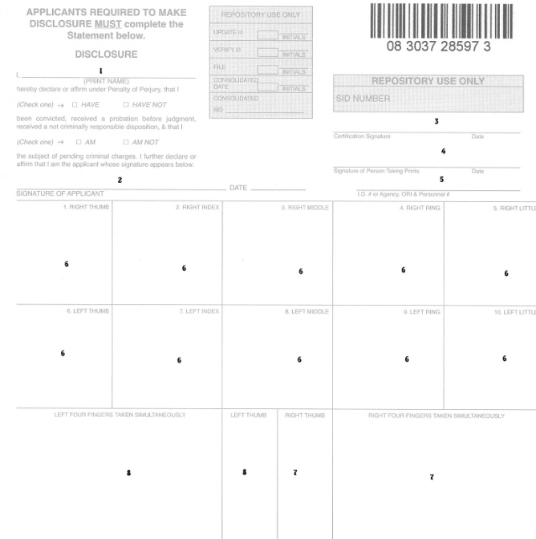
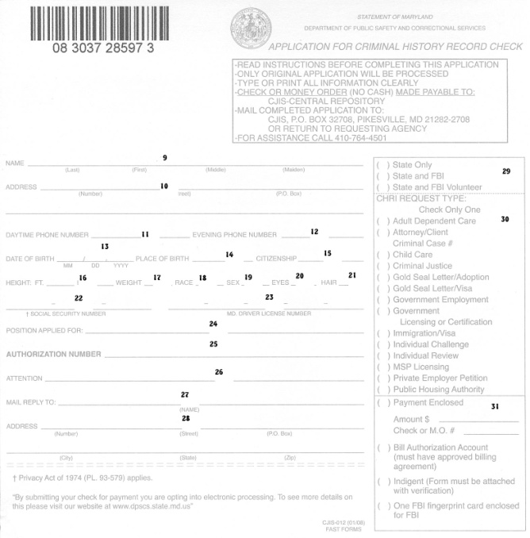

ACCURACY
The degree to which the data on the fingerprint card matches the source documents.
Source Documents
Fingerprint Card

Slide 12
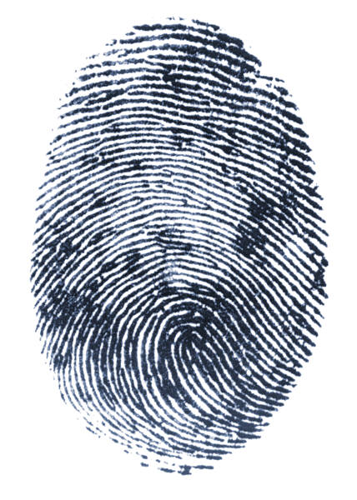
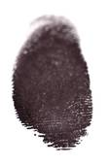
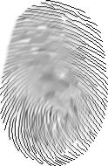

Fingerprint Quality
The clarity, resolution and readability of the fingerprints impressions.
Distorted
Smeared
Clear

Slide 13
Limited Access To CHRI
Access to CHRI should be limited to those individuals directly involved in the hiring process and who have been the subject of a fingerprint based background check.

Slide 14
Storage and Security of CHRI
CJIS Security Policy 5.5, Section 4.2.1
Title 5, U.S.C. 552a
Requires agencies “to maintain a system of records which establish appropriate administrative, technical, and physical safeguards to ensure the security and confidentiality of records.”

Slide 15
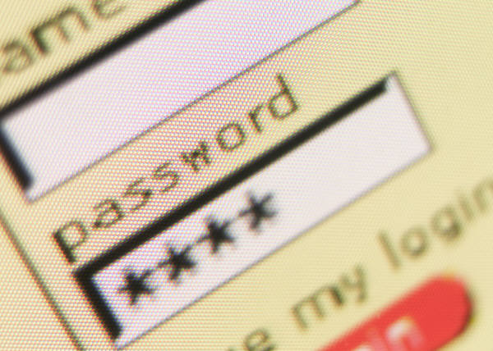
Breach In Security
Precautions or measures should be taken to ensure that all criminal history information is guarded from attack, theft or improper disclosure.
Should there be a Breach in the security of the CHRI, notify CJIS immediately
Notify those persons who are affected by the Breach.
If the Breach involved a criminal wrong doing; notify the police.

Slide 16

PROCEDURES FOR HANDLING CHRI
CJIS Security Policy 5.5, Section 5.5
The agency will maintain adequate records of all transactions and events using a log which can be electronic or manual. The log records all external, internal and authorized governmental agency requests for CHRI.

Slide 17
Reason Fingerprinted
Ensure a specific reason for each fingerprint transaction is provided upon request, and that the reason fingerprint field accurately represents the purpose/ or authority for the Use of Criminal History record Information (CHRI)

Slide 18

USE OF CHRI/DISSEMINATION
CHRI shall be only used for the purpose for which it was disseminated, and it may not be re-disseminated.

Slide 19
Dissemination of CHRI
The exchange of records and information…….is subject to cancellation if dissemination is made outside the receiving departments or related agencies.
The FBI has no objection to you sharing the criminal history with the applicant for review and possible challenge when the record was obtained based on a positive identification.

Slide 20
Dissemination of CHRI (cont’d)
This courtesy will save the applicant the time and fees of going to the FBI to obtain this information, and will allow for a more timely determination of the applicants suitability.

Slide 21
DESTRUCTION OF CHRI
CHRI when no longer needed, shall be destroyed by shredding.
When using a commercial company for shredding, the process shall be witnessed by someone in your agency who has had a fingerprinted based background check.

Slide 22
CJIS Security Policy 5.5
The current CJIS Security Policy is version 5.5 dated June 2016.
http://www.fbi.gov/about-us/cjis/cjis-security-policy-resource-center

Slide 23
Agency Privacy Requirements for Non- Criminal Justice Applicants
Officials must provide written notice to the applicant that their fingerprints will be used to check the criminal history records of the FBI.
Officials using the FBI criminal history record to make a determination of the applicants suitability for the job, license, or other benefit must provide the applicant the opportunity to complete or challenge the accuracy of the information in the record.

Slide 24
Agency Privacy Requirements for Non- Criminal Justice Applicants
Officials must advise the applicant that procedures for obtaining a change, correction, or updating of an FBI criminal history record are set forth at Title 28, Code of Federal Regulations, Section 16.34
Officials should not deny the job, license, or other benefit based on information in the criminal history record until the applicant has been afforded a reasonable time to correct, or complete the record or has declined to do so.

Slide 25
Audit FYI’s
Non- Criminal Justice Agencies are subject to audits by the Federal Bureau of Investigation
FBI audits on a 3- year cycle
FBI randomly selects agencies to audit
CJIS focuses on the same areas as the FBI audits
CJIS and the Agency are jointly responsible for any findings.

Slide 26
Audit Results
Reported only to the Audited Agency
Agency is required to respond to findings and recommendations within 30 days of receiving the final report
CJIS will follow –up for compliance as necessary
Sanctions can be imposed

Slide 27
QUESTIONS

Slide 28
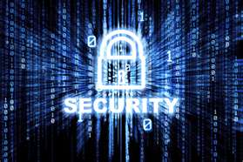
Criminal History Record Information
Security Awareness Training
CRIMINAL JUSTICE INFORMATION SYSTEM
CENTRAL REPOSITORY
Notes:
This presentation is provided as a tool to comply with the Federal Bureau of Investigation (FBI) Criminal Justice Information System (CJIS) Security Policy.
It is provided as a guide and may be adapted to meet your specific Criminal History Record Information security training needs.

Slide 29

Objectives
To enhance awareness and understanding of:
Criminal History Record Information (CHRI) Security
Information Assets
Information Classification
Information Security Practices
Accessing Information
Notes:
The objective of this training is to enhance your awareness and understanding of :
The purpose of CHRI security.
Why CHRI security is necessary.
Challenges that CHRI security present
What is meant by CHRI Assets.
Your responsibilities to maintain CHRI security.
The requirements to be compliant and the consequences of not complying
The FBI’s Security Policies and practices developed to help comply with Federal and State requirements.
Your responsibilities in handling and protecting CHRI

Slide 30
Who Must Receive Training?
Anyone requesting, receiving, or handling Criminal History Record Information (CHRI), in any manner. This includes IT network employees and technical contractors when CHRI is stored on PCs or on a network.
.
Notes:
Anyone requesting, receiving, or handling Criminal History Record Information (CHRI) in any fashion is required to receive Security Awareness Training every 2 years. This includes but is not limited to anyone requesting, receiving, handling, storing, securing, or destroying CHRI This includes contractor and vendor personnel who are employed or contracted to perform administrative tasks for you and includes your PC/Network/System technicians if CHRI is stored on a PC or network.
Any employee who meets this criteria must receive their initial Security Awareness training within 30 days of employment or contract, and subsequently, every 2 years thereafter.

Slide 31
How Often is Training Required?
Initial training is required within 30 days of initial employment.
FBI Criminal Justice Information System Security Policy 5.5 dated June 2016
requires training every 2 years, thereafter
Notes:
The FBI’s CJIS Security Police version 5.1 dated July 2012 requires Security Awareness Training every two years.
Everyone who meets the criteria mentioned earlier, including IT employees, contractors, and vendors must be trained every 2 years.
Information Security is
Identifying and defining the value of CHRI data, systems, facilities, and other organizational resources.
Classifying those items to determine how to handle and protect them. These are the key protective elements:
Confidentiality: protecting CHRI from inappropriate disclosure. Individually identifying information that if released could result in harm to a person or organization.
Integrity: Keeping CHRI correct and reliable by protecting it from unauthorized changes or manipulation.
Availability: Protecting CHRi to ensure it is available when needed to perform work functions.

Slide 32
Must Training Be Documented?
YES!
A record of CHRI Security Training must be maintained and available for audit by FBI or MD DPSCS/CJIS-CR auditors.
Training records must be maintained for a minimum of three years.
Notes:
Security Awareness training must be documented and made available upon request by authorized State and Federal representatives of the Criminal Justice Information System for audit purposes.
Training records must be maintained for a minimum of 3 years.

Slide 33
What Information Must Be Documented?
As a minimum:
Date and duration of training
Names and Identifying Information of attendees.
Notes:
Your training records must indicate the date and duration of the training and must include a list of attendees with sufficient identifying information to confirm that all employees who meet the criteria receive the required training.
Training does not need to be conducted in a classroom setting. You may allow individuals to review the Information Security Awareness training material individually or in small groups.

Slide 34
What Topics Must Be Covered?
As a minimum:
Responsibilities and expected behavior.
Implications of non-compliance
Reporting incidents
Protective Actions
Visitor Control and Physical Access
Protecting Information
Notes:
Section 5.2.1.1 of the CJIS Security Policy, Version 5.1, dated July 2012 requires the following topical areas to be included, as a minimum, in the required Security Awareness Training program.
Rules that assign and describe responsibilities and expected behavior in regards to handling Criminal History Record Information (CHRI)
Possible penalties for violating federal and state laws concerning the proper handling of CHRI
How to respond to and report suspected incidents of violation or breach of security concerning the handling of CHRI
Protecting any type of media used when handling CHRI

Slide 35
What Topics Must Be Covered? (cont’d)
As a minimum:
Proper handling of Criminal History Record Information (CHRI)
Threats, Vulnerabilities, and Risks of Handling CHRI
Proper Dissemination and Destruction of CHRI
Notes:
Proper marking and handling of hardcopy CHRI
Possible threats, vulnerabilities, and risks associated with handling CHRI
Proper dissemination and disposal/destruction of CHRI when it is no longer needed.
All of these topics will be covered in this session.

Slide 36
Audit Results
Reported only to the Audited Agency
Agency is required to respond to findings and recommendations within 30 days
Follow- Up for compliance as necessary
Sanctions, although available, are not yet being imposed

Slide 37
FYI’s
Non- Criminal Justice Agencies are subject to audits by the Federal Bureau of Investigation
FBI audits on a 3-year cycle – next audit is 2017
FBI randomly picks agencies to audit
CJIS focuses on the same areas as FBI audits
CJIS-CR and Agency are jointly held responsible for any findings

Slide 38
Statistics On Non Criminal Audits

Slide 39
Best Business Practices
All employees with access to CHRI shall be the subject of a fingerprint supported background check.
Access must be limited to essential personnel with a valid need to know.
Security Awareness training within 60 days of employment, and every 2 years after that- Documented
Notify CJIS-CR Customer Service by fax at 410-653-5690 when an employee transfers out of the agency, resigns from the agency or otherwise leaves employment at the agency.
Know your primary private providers-
http://www.dpscs.state.md.us/publicservs/fingerprint.shtml/

Slide 40

Questions

Slide 41
CJIS Customer Response Service Unit
410-764-4501
Toll Free Number
1-888-795-0011
www.dpscs.maryland.gov

